Slide 1
Harmonium: Asymmetric, Bandstitched UWB for Fast, Accurate, and Robust Indoor Localization
Benjamin Kempke Pat Pannuto Prabal Dutta University of Michigan
IPSN 2016

Slide 2
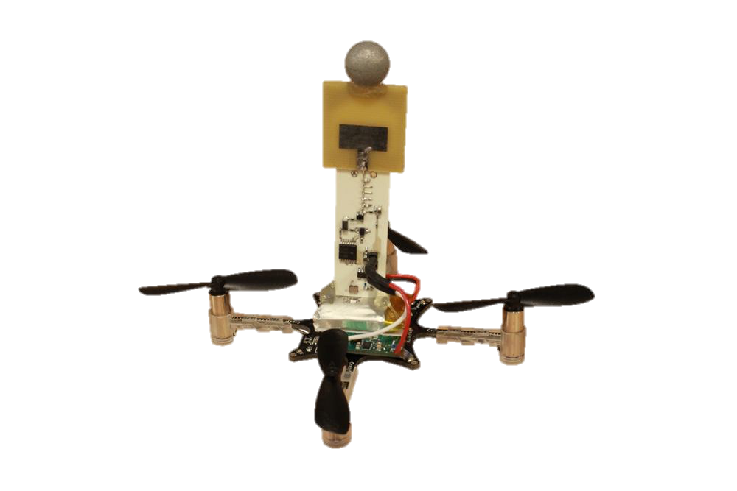
What is Harmonium?
High-quality indoor localization
The CrazyFlie Nano
Fast (> 1 m/s), small (5 g payload), flying machine

Slide 3
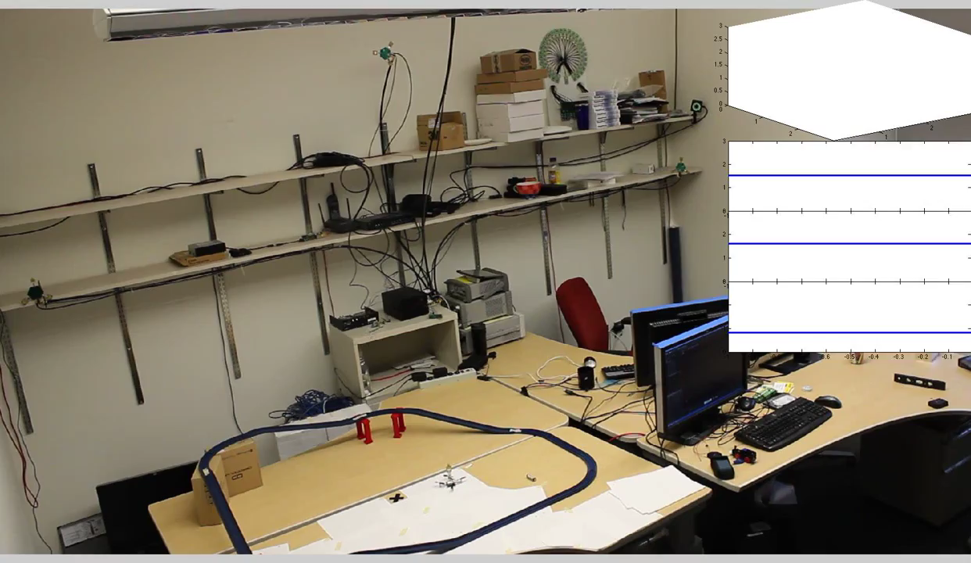
Harmonium tracks microquadrotors in real time with 14 cm accuracy

Slide 4
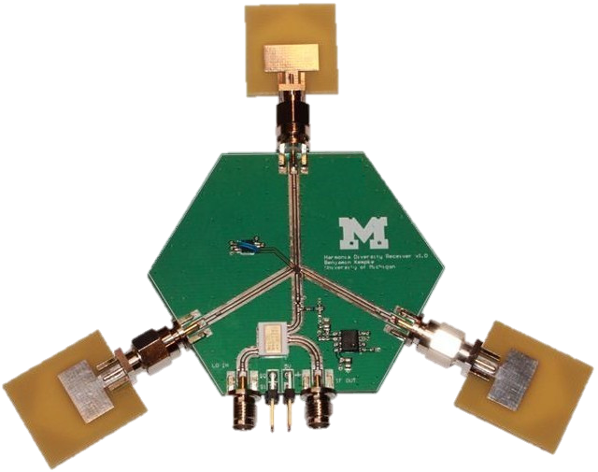
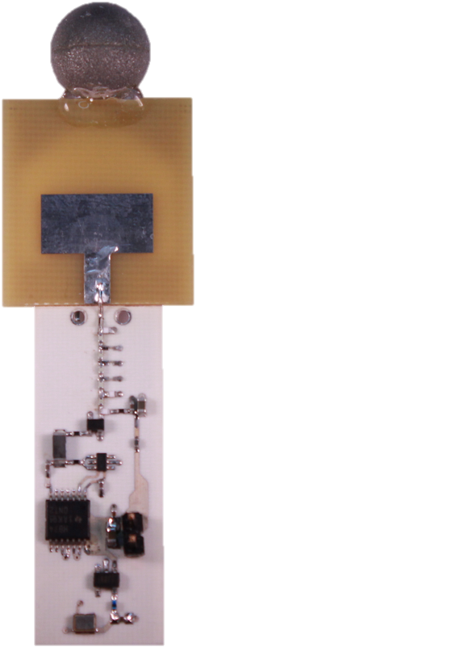
How does Harmonium do it?
Time Difference of Arrival

Slide 5
What makes Harmonium different?
Pushes most complexity from the node to localize to fixed infrastructure
Tags are:
Inexpensive
Low-power
Lightweight
Harmonium solves the shortcomings of current RF localization technologies
Achieves high accuracy in multipath-rich environments
Receiver uses well-studied traditional narrowband architecture
Composed of only common, off-the-shelf components
Notes:
High precision localization syst

Slide 6
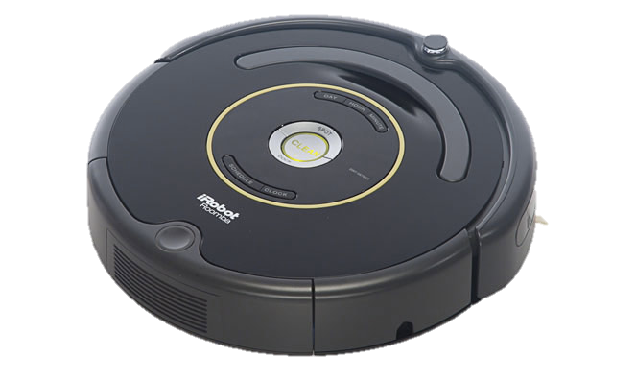
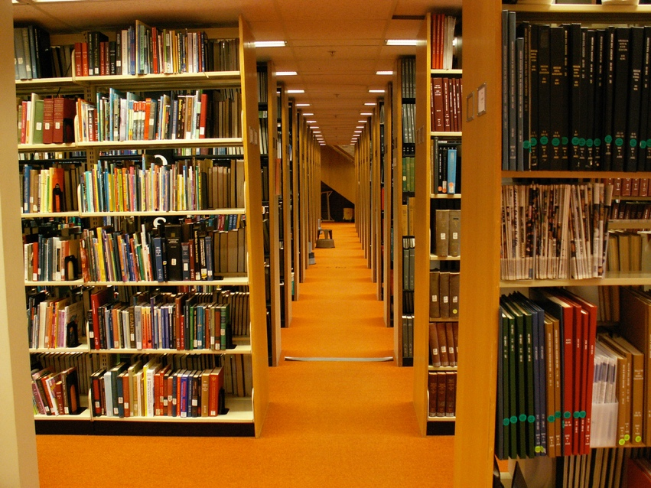
Why Bother with Indoor Localization Anyway?
Autonomous Robotics
Asset Tracking
Location Attestation
http://www.irobotweb.com/~/media/Images/iRobot/Robots/HRD/Roomba/600%20Series/Anatomy/irobot-roomba-600-sideview.jpg?h=397&la=en&w=663
https://farm2.staticflickr.com/1313/556806349_e38a6a2668_b_d.jpg
http://i.dailymail.co.uk/i/pix/2012/07/16/article-2174271-14150BDF000005DC-987_634x372.jpg
http://i.cbc.ca/1.2447541.1385989501!/fileImage/httpImage/image.jpg_gen/derivatives/16x9_620/amazon-drone.jpg
http://cdn.wonderfulengineering.com/wp-content/uploads/2013/06/Amazon-warehouse.jpg
Notes:
Drone -> delivery drone
Attestation -> unlock office, pay for coffee

Slide 7
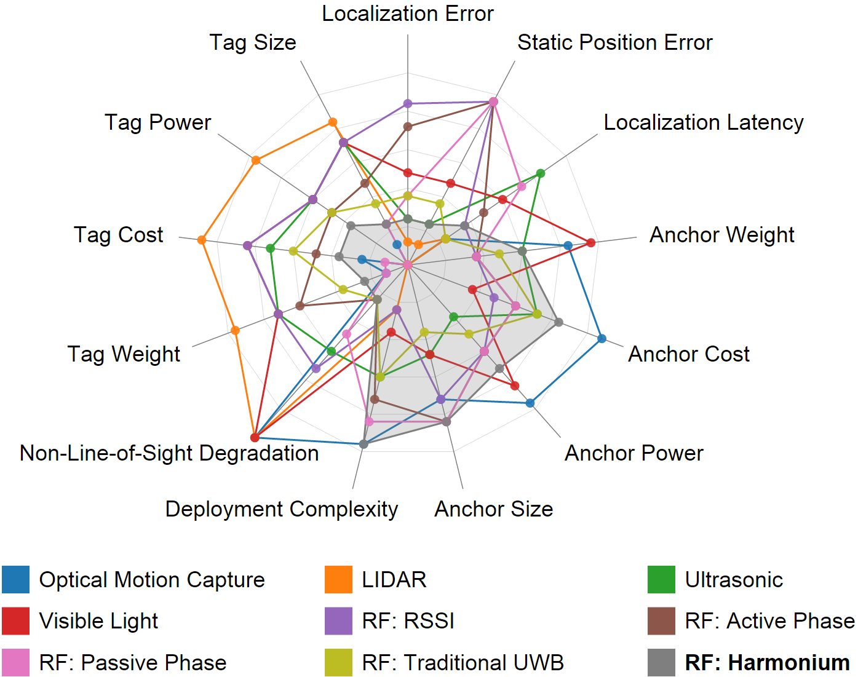
Hasn’t indoor localization been done before? Why Harmonium?
Harmonium prioritizes
Location quality
Tag Simplicity
At the cost of anchor complexity
Notes:
Smaller is better
Harmonium focuses on tag metrics and localization accuracy, where it excels

Slide 8
So, how does Harmonium do it?
D?

Slide 9
Harmonium measures the Time Difference of Arrival
D1
D1 – D2
D2
Tag Send

Slide 10
Multilateration: Time-Difference-of-Arrival to Location

Slide 11
Multilateration: Time-of-Arrival to Location

Slide 12
In the real world, it is hard to accurately measure these distances

Slide 13
IPSN’15 Microsoft Indoor Localization Competition: A strong indicator of localization performance
http://research.microsoft.com/en-US/events/indoorloccompetition2015/2015_indoorloc_competition_light.pptx
Notes:
2015 Localization Competition results
Comparison: Accuracy vs. BW

Slide 14
The majority of indoor localization systems use RF
Can operate in non-line-of sight
High speed
Moderate energy and cost
http://research.microsoft.com/en-US/events/indoorloccompetition2015/2015_indoorloc_competition_light.pptx
Notes:
2015 Localization Competition results
Comparison: Accuracy vs. BW
Rewrite titles to make sense, thrown off otherwise

Slide 15
And the best RF-based systems use Ultra-Wideband (UWB)
http://research.microsoft.com/en-US/events/indoorloccompetition2015/2015_indoorloc_competition_light.pptx
Notes:
2015 Localization Competition results
Comparison: Accuracy vs. BW

Slide 16
What is Ultra-Wideband?
Time Domain
Frequency Domain
5.31 GHz
5.33 GHz
Narrowband
5 GHz
6 GHz
Ultra-Wideband
Notes:
Add in frequency domain duals

Slide 17
Why does ultra-wideband give better range estimates?

Slide 18
Why does ultra-wideband give better range estimates?

Slide 19
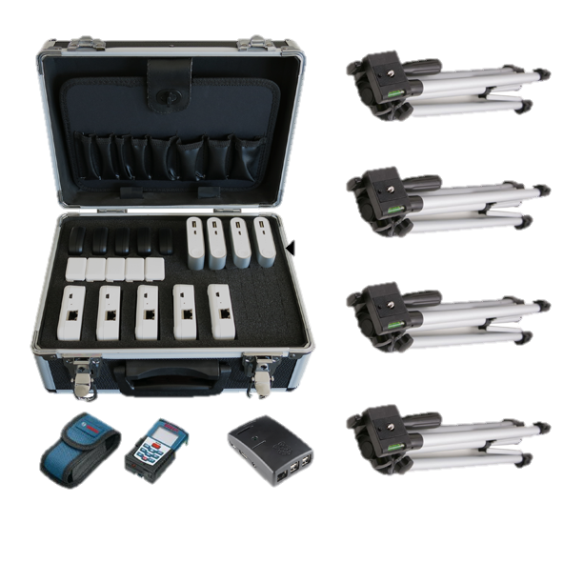
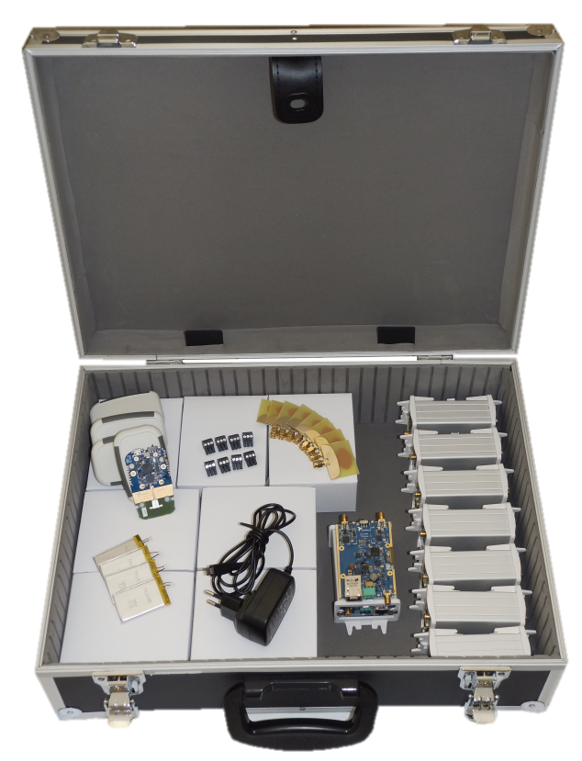
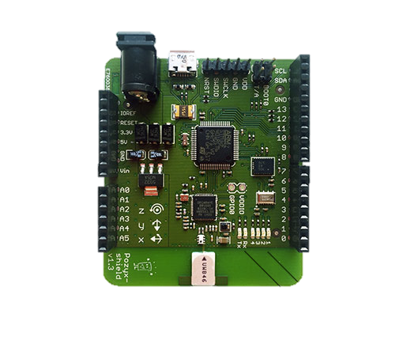
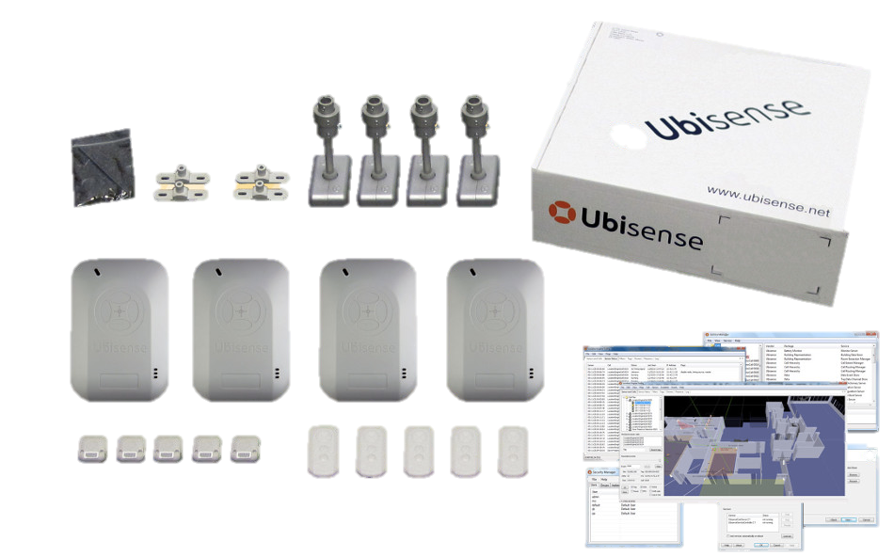
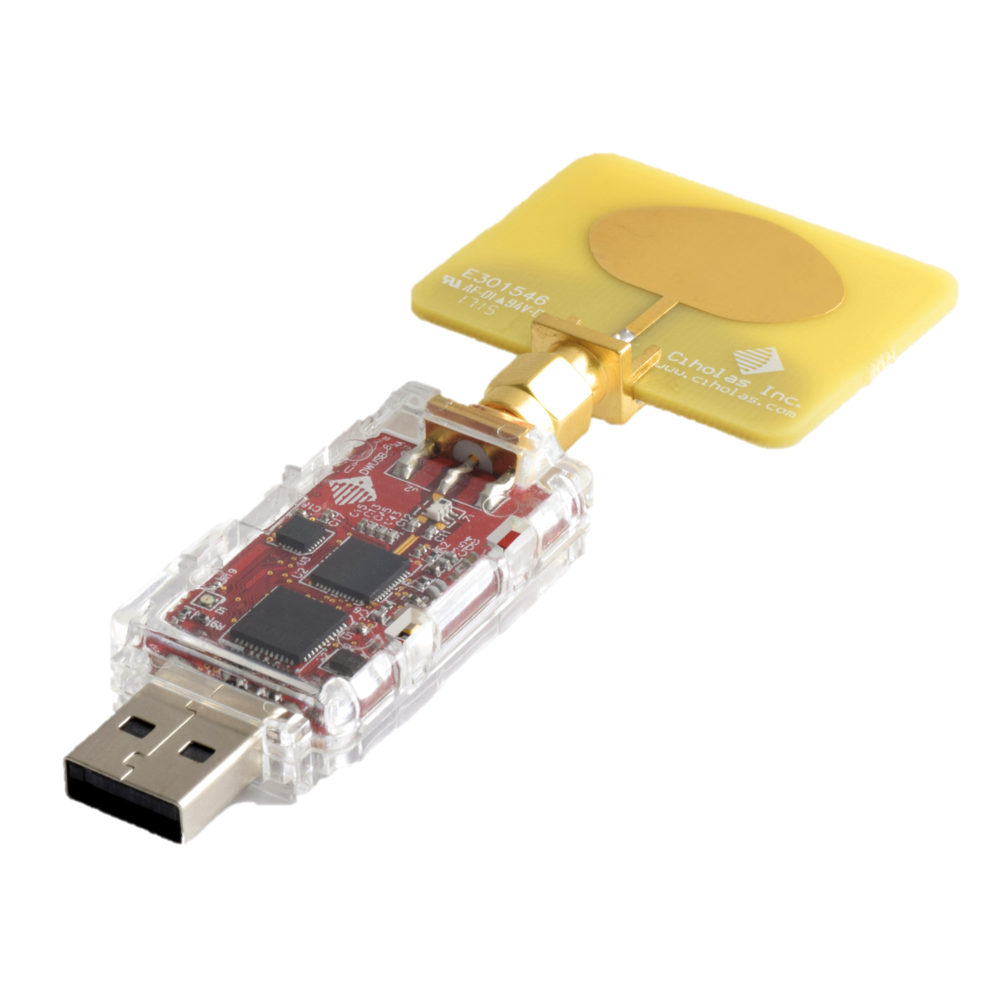
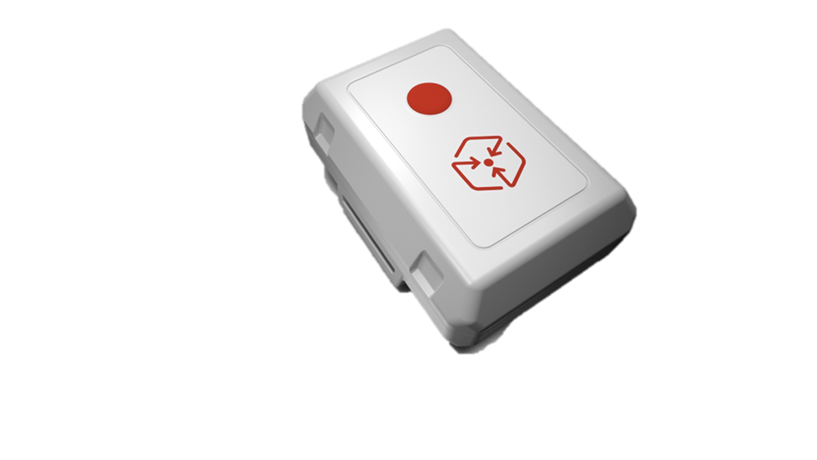
If we want to use UWB today, what’s available?
Commercial RTLS
802.15.4a Transceiver (DecaWave)
Sewio
TimeDomain P330
OpenRTLS
TimeDomain P440
Pixie
Pozyx
Ubisense Research Package
Ciholas DWUSB
Redpoint Positioning

Slide 20
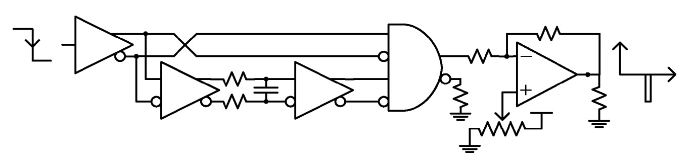
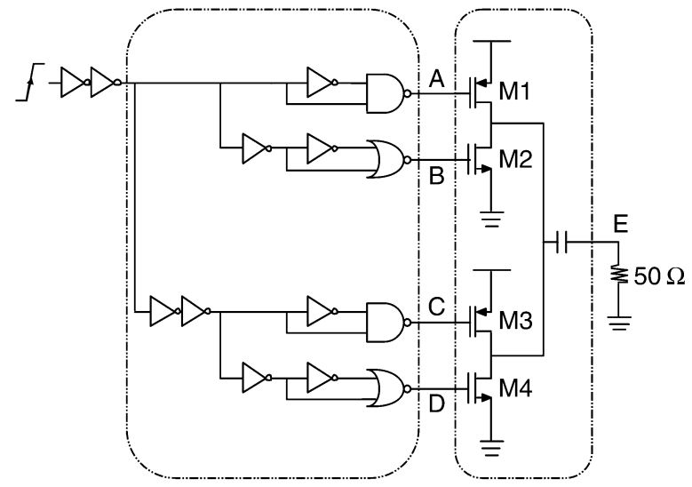
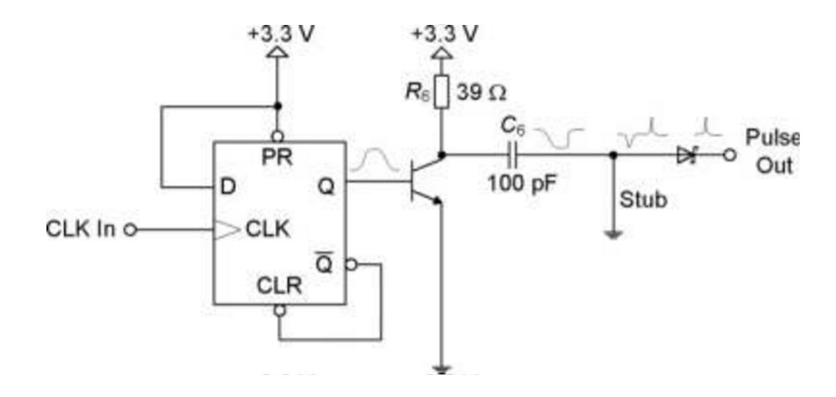
What if we want to build our own UWB transmitter?
X
Major types
High-Speed Comparators
SRD-Based
CMOS
BJT-Based
X
Wentzloff, David D., and Anantha P. Chandrakasan. "Gaussian pulse generators for subbanded ultra-wideband transmitters." Microwave Theory and Techniques, IEEE Transactions on 54.4 (2006): 1647-1655.
Kim, Hyunseok, D. Park, and Y. Joo. "All-digital low-power CMOS pulse generator for UWB system." Electronics Letters 40.24 (2004): 1.
Hantscher, Sebastian, et al. "Hardware concepts for the sequential sampling of repetitive pulse radar echoes in cost‐efficient ultra‐wideband transceivers."Microwave and Optical Technology Letters 52.3 (2010): 585-591.

Slide 21
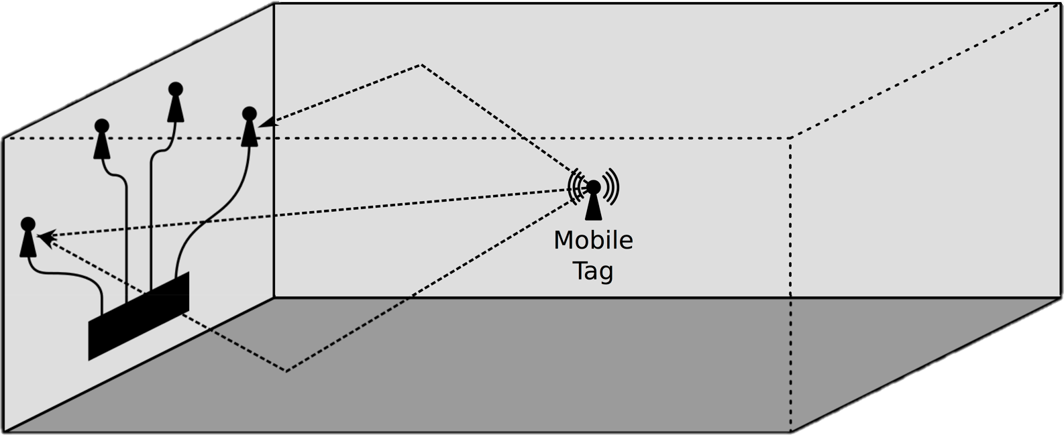
Harmonium: The Architecture

Slide 22
Harmonium: The Tag
Concept of operation:
BJT NPN Pulse generator
Monoflop generator
Pulse Repetition Frequency (PRF) generator
Trigger filter
Pulse-shaping filter
Tag specs:
Pure COTS design
$4.50 in modest quantity
75 mW active power

Slide 23
Harmonium: The Tag
Notes:
Notes: Uses ASE-4.000MHZ-LC-T (+/- 50 ppm)

Slide 24
Harmonium: The Tag

Slide 25
Harmonium: The Tag

Slide 26
Harmonium: The Tag

Slide 27
Harmonium: The Tag

Slide 28
Harmonium Tag: The Need for Filtering
Pulse w/o filtering → Pulse w/ trigger filtering → Pulse w/ shaping filter

Slide 29
Harmonium Tag: The Need for Filtering
Pulse w/o filtering → Pulse w/ trigger filtering

Slide 30
Harmonium Tag: The Need for Filtering
Pulse w/o filtering → Pulse w/ trigger filtering

Slide 31
Harmonium Tag: The Need for Filtering
Pulse w/o filtering → Pulse w/ trigger filtering → Pulse w/ shaping filter

Slide 32
How to measure the time of arrival of pulses from the tag?

Slide 33
Commercial UWB receivers expect standard packets and modulation

Slide 34
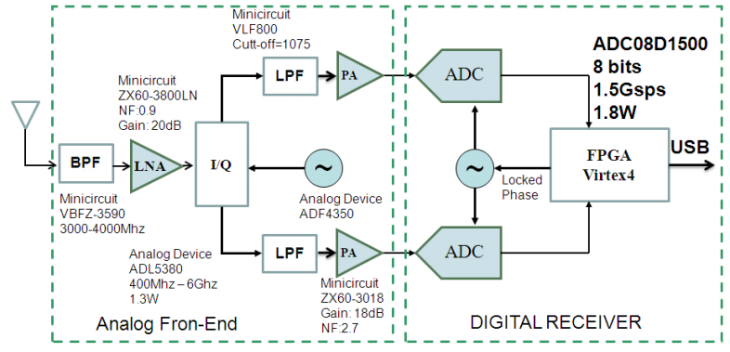
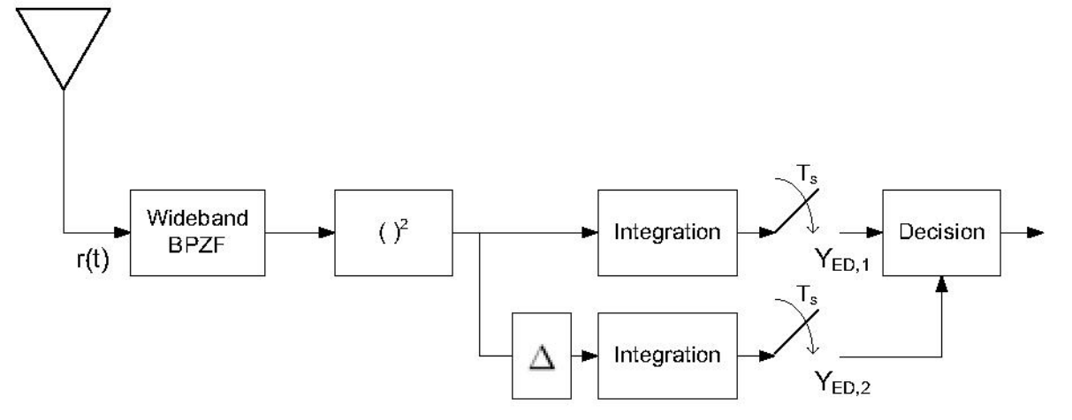
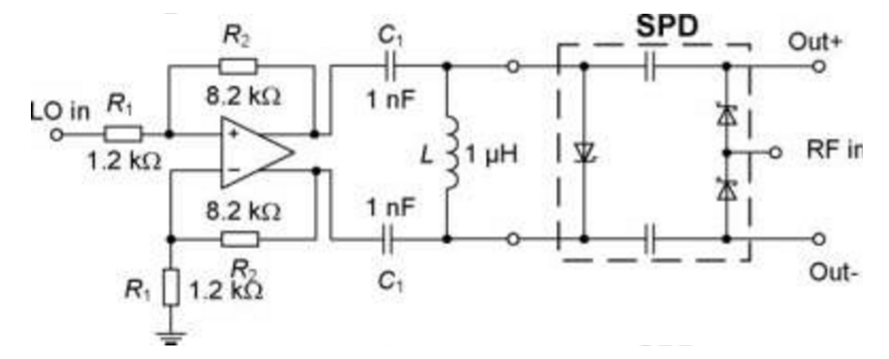
UWB receivers from research are too expensive, noisy, or niche
X
UWB Receivers
High-Speed ADCs
Energy detection receivers
Sampling Receivers
X
X
Segura, Marcelo, et al. "Experimental demonstration of self-localized ultra wideband indoor mobile robot navigation system." Indoor Positioning and Indoor Navigation (IPIN), 2010 International Conference on. IEEE, 2010.
Rabbachin, Alberto, et al. "UWB energy detection in the presence of multiple narrowband interferers." Ultra-Wideband, 2007. ICUWB 2007. IEEE International Conference on. IEEE, 2007.
Hantscher, Sebastian, et al. "Hardware concepts for the sequential sampling of repetitive pulse radar echoes in cost‐efficient ultra‐wideband transceivers."Microwave and Optical Technology Letters 52.3 (2010): 585-591.

Slide 35
In the real-world, UWB is not alone
http://www.theiet.org/resources/journals/eletters/4811/images/640_uwb-spectrum2.jpg

Slide 36
Harmonium: UWB Reception with Narrowband Radios
Concept of operation:
Generic narrowband receiver
Frequency-swept local oscillator
Antenna diversity

Slide 37
Harmonium: UWB Reception with Narrowband Radios
Concept of operation:
Generic narrowband receiver
Frequency-swept local oscillator
Antenna diversity

Slide 38
Harmonium: UWB Reception with Narrowband Radios
Concept of operation:
Generic narrowband receiver
Frequency-swept local oscillator
Antenna diversity

Slide 39
Harmonium: UWB Reception with Narrowband Radios
Concept of operation:
Generic narrowband receiver
Frequency-swept local oscillator
Antenna diversity

Slide 40
Harmonium: UWB Reception with Narrowband Radios
Concept of operation:
Generic narrowband receiver
Frequency-swept local oscillator
Antenna diversity

Slide 41
Harmonium: UWB Reception with Narrowband Radios
Concept of operation:
Generic narrowband receiver
Frequency-swept local oscillator
Antenna diversity

Slide 42
Harmonium reconstructing UWB signals in the real world

Slide 43
Time-Domain Representation to Time-of-Arrival

Slide 44
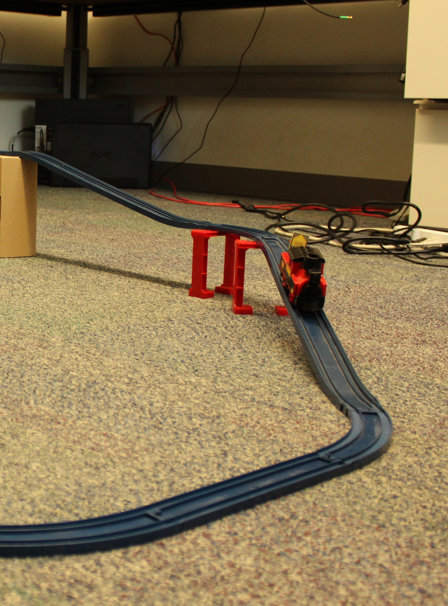
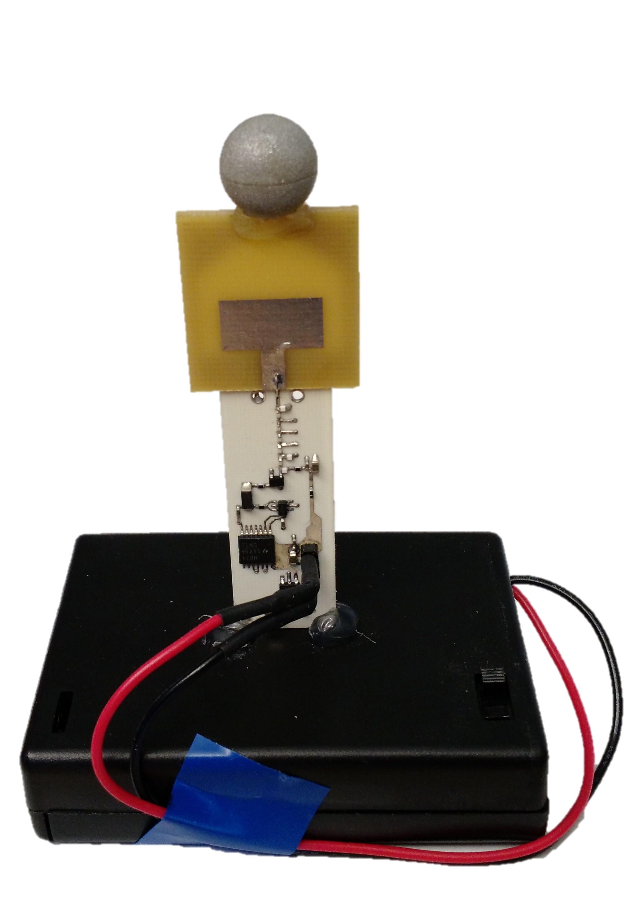
How well does Harmonium actually work?
Experiment #3:
Mobile Localization (Reproducibility)
Experiment #1: Stationary Accuracy
Experiment #2:
Mobile Localization Accuracy

Slide 45
Experimental Evaluation #1: Stationary Accuracy
Stationary, Unobstructed
Stationary, Obstructed
14 cm median error
16 cm median error

Slide 46
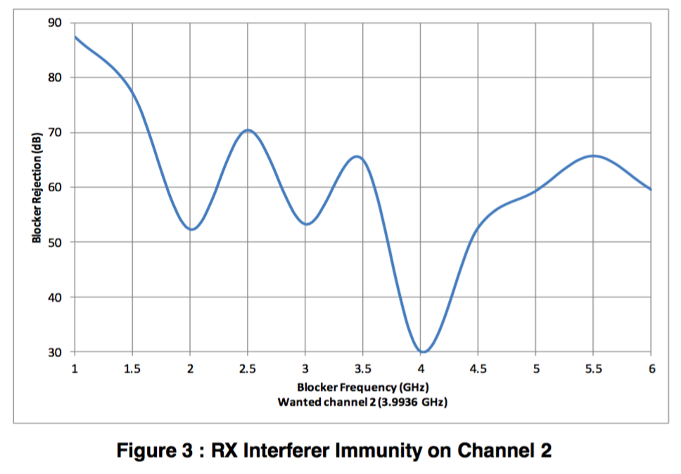
Commercial UWB receivers fail in the presence of narrowband interferers
Spectrum is becoming increasingly crowded
UWB fails with modest narrowband interference
DW1000 Datasheet

Slide 47
Harmonium still able to achieve accurate location estimates in the presence of narrowband interference
28 cm median error
Notes:
Technique used: “Robust Uncertainty Principles: Exact Signal Reconstruction from Highly Incomplete Frequency Information” (Convex optimization problem)

Slide 48
Experimental Evaluation #2: Tracking Micro-Quadrotors
14 cm median error
46 cm 95%ile error
Up to 1.4 m/s
19 Hz sampling

Slide 49
Future Extensions
Digital Communication
Multi-tag support

Slide 50

Conclusions
Harmonium introduces novel UWB transmitters, receivers, and signal processing techniques
Harmonium increases anchor complexity to realize minimal tags
1.5 cm³, 75 mW, 3 g
Harmonium is a robust, high-precision indoor localization technology
14 cm median error
16 cm median error “through “the walls”
28 cm median error in the face of narrowband interference
Ben Kempke, Pat Pannuto, and Prabal Dutta

Slide 51
Backup Slides

Slide 52
The Disadvantages of UWB Reception with Narrowband Receivers
Maximum attainable update rate goes down proportional to the number of required observations
More complex signal processing required to reconstruct wideband channel representation

